Slide 1
Build a Portfolio Website
(basics of React.js and TailWindCSS)
Anzhelika Kurnikova

Slide 2
Agenda
Overview
What websites consist of?
What will we be using?
Pre-requirements
Coding
Overall view of the website
Conclusion

Slide 3
Overview

Slide 4



What websites consist of?
The 3 web development technologies that all websites are built with.
HTML (HyperText Markup Language) – defines structure of the
website (what sections our website will have, what each section has
and etc.)
CSS (Cascading Style Sheets) – makes what is defined by HTML stylish
(does colors, margins, fonts, borders, animations and etc.)
JavaScript – programming language that does all logic (add to cart in
online store, opens modal window when button is clicked, submits a form).

Slide 5

What will we use?
React.js – JavaScript library for Frontend Development that is built by Meta.
Reasons why:
- React.js has JavaScript, HTML and CSS within the same file (less issues with files, easy to find code that we need)
- React.js allows us to create components (like a button, a checkbox, a header) that allows us to easily reuse the existing code
- React.js allows us to easily make websites interactive

Slide 6

What will we use?
Tailwind CSS – CSS framework that simplifies and speeds up the CSS developments
Reasons why:
- Tailwind CSS allows you to build and style web components quickly by applying utility classes directly to HTML elements
- Tailwind CSS has consistent styles, which means if you use them, you have consistent code
- Tailwind CSS simplifies adaptation of your website to mobile devices (small screens)

Slide 7
Prerequirements

Slide 8

What to download?
Actually, nothing.
Today we will program in online tool to avoid problems and delays because of the installations.
To follow along:
Open the online tool with pre-made code https://codesandbox.io/s/hackjam-starter-code-kyldwv or QR code
Create a free account on the website
Press the “Fork” button to make your copy of the code

Slide 9
Coding

Slide 10
Overall view
What parts will our website have?
Like most portfolio websites it will be one page website with sections:
Intro
Project
Skills
Education
Work Experience
Footer
Let’s look what pre-made code has.

Slide 11
Conclusion

Slide 12

Conclusion
Learned the concept of HTML, CSS, JS
Learned the basics of using React.js and Tailwind CSS
Made a simple portfolio website
Full code (in case if you need it)
https://codesandbox.io/s/hackjam-full-code-ssdpc6

Slide 13
Next Events

Slide 14
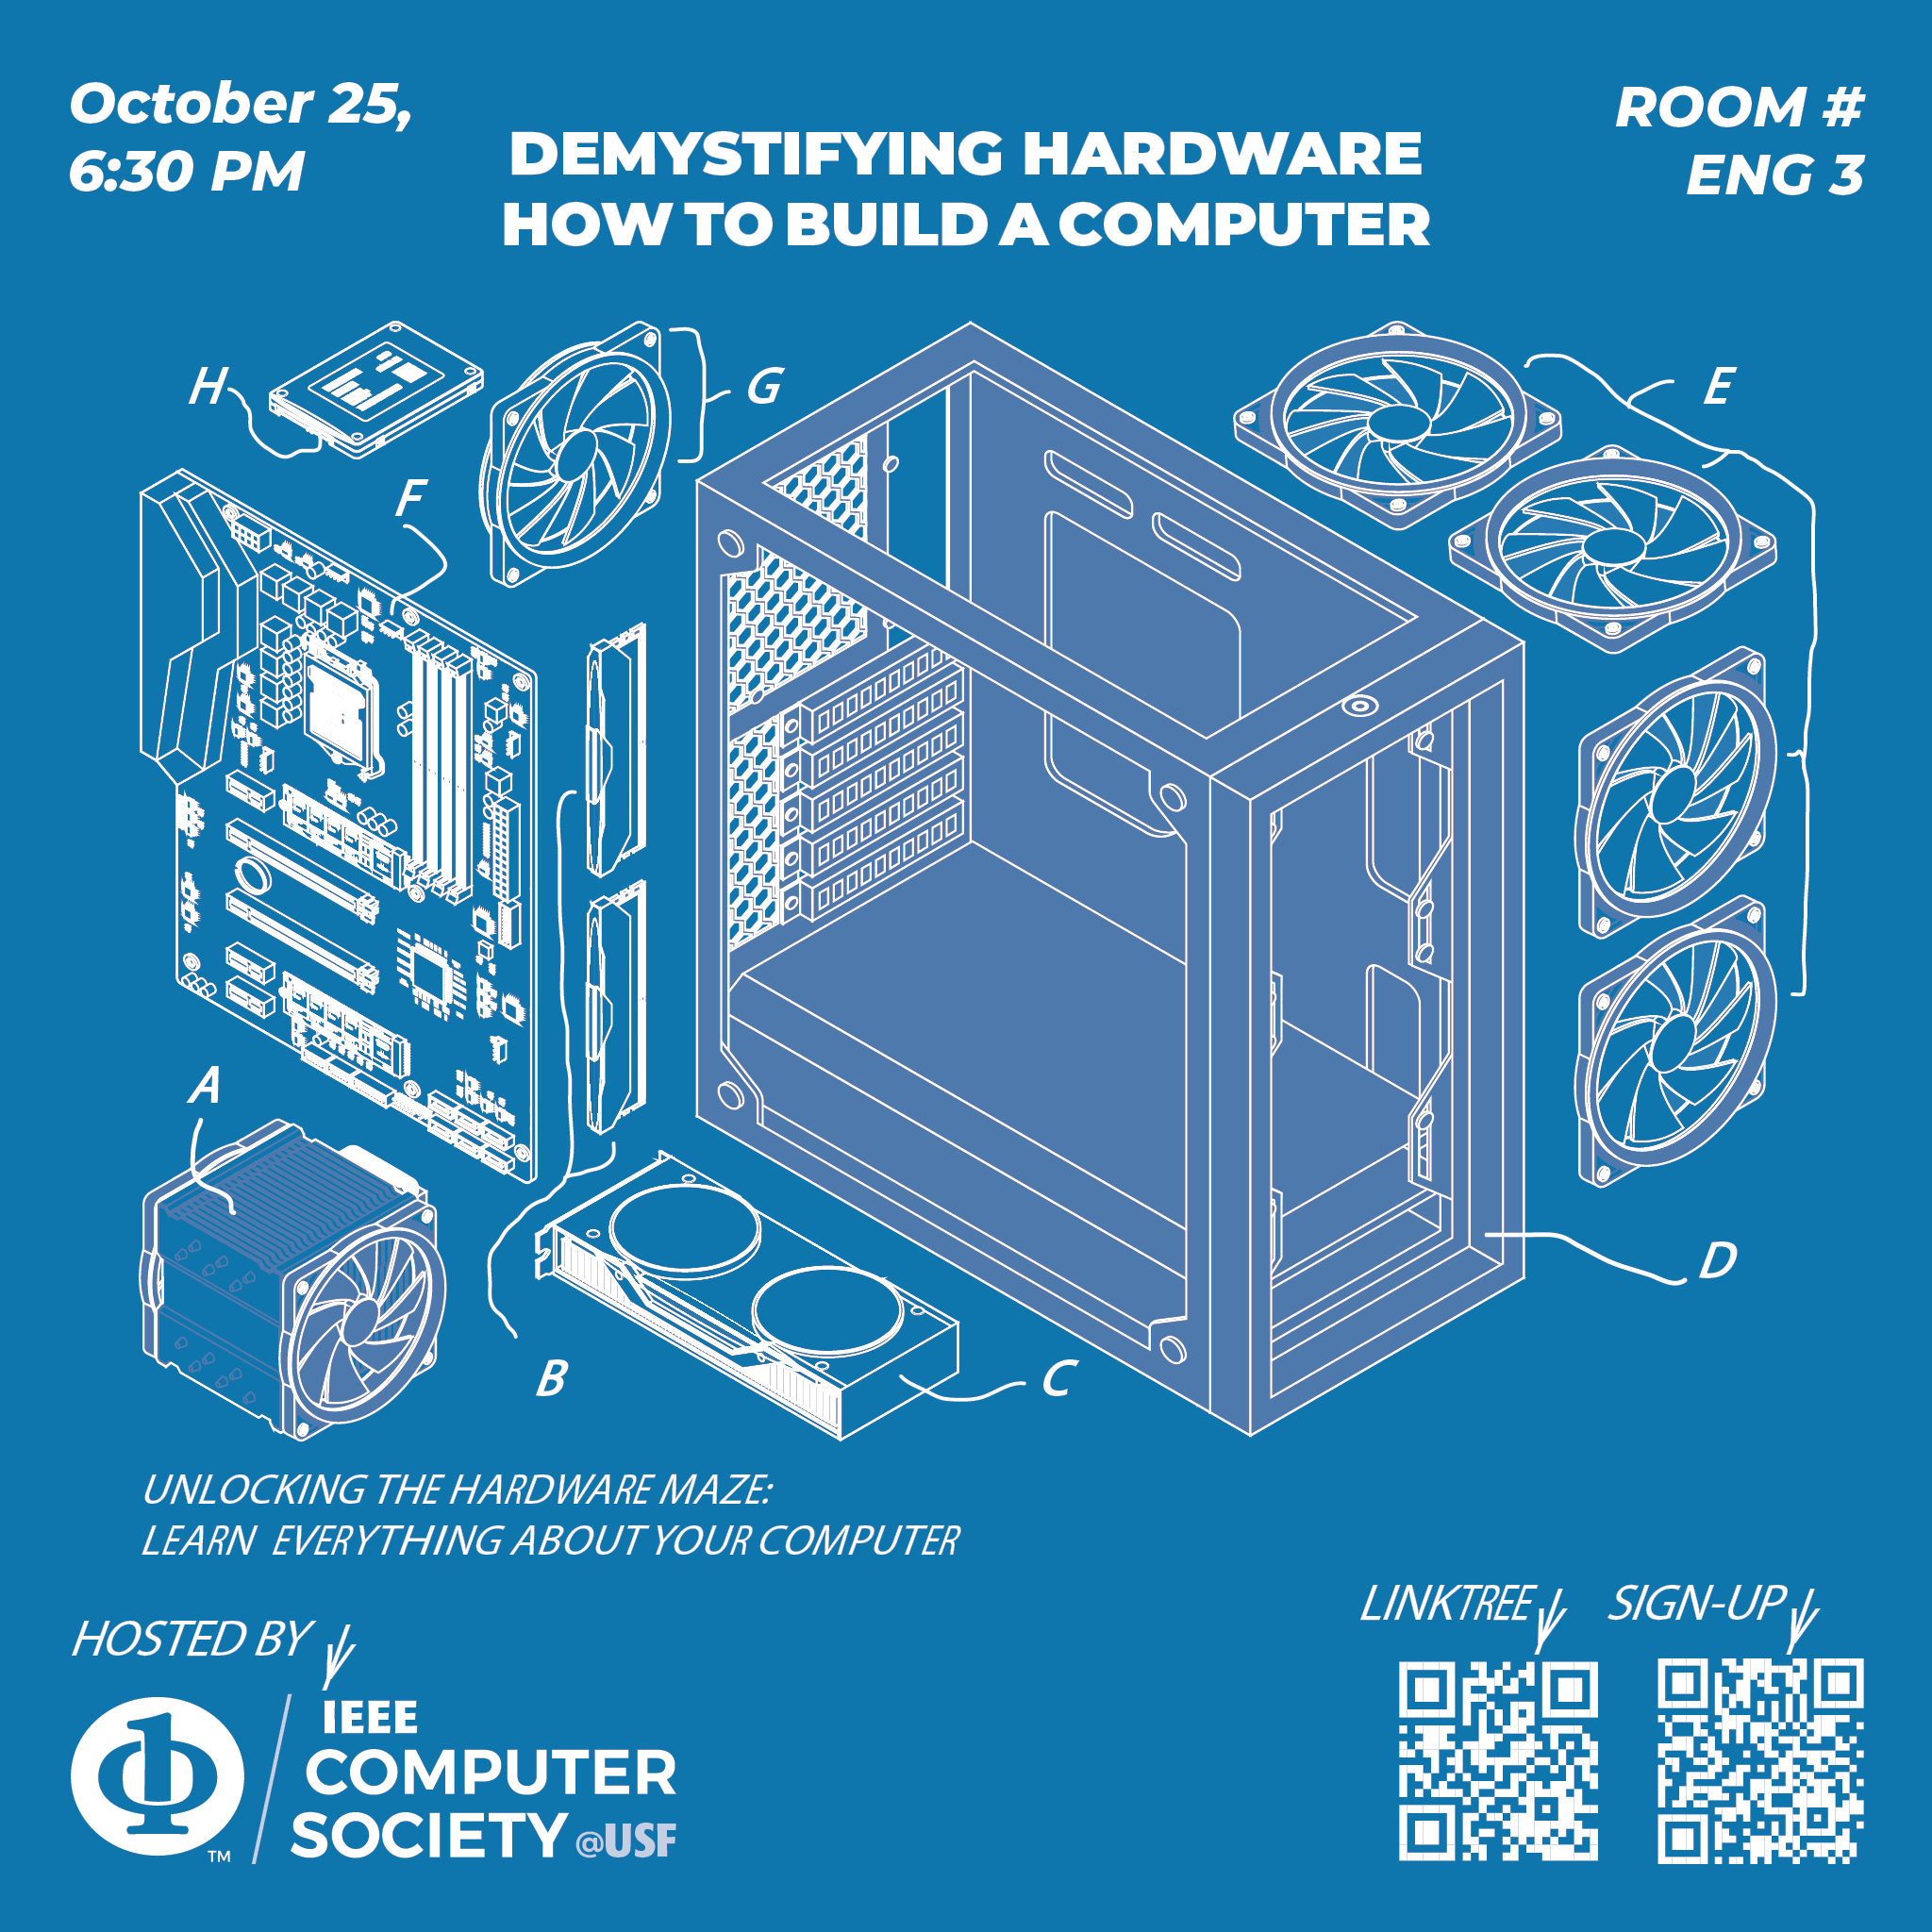
Next Events

